Slide 1
Automation Documentation Creation
Automation Documentation Creation
Doanh Nguyen Aayush Dalal Regina Meneses Najaf Ali
Mentor: Eric Testerman

Slide 2
Project Topic
Extend existing automation to automate the documentation, by developing an Ansible plug-in, allowing playbooks to map out environments to other data points, such as Confluence, etc., to easily be documented.

Slide 3
Tasks
Teams and Goals
Research
Complete 4 of 9 project requirements
Complete next 3 of 9 project requirements (7 of 9)
Complete all project requirements
Testing
Launch

Slide 4
Task Description
Teams and Goals
  Make teams, meet and speak with mentor and create goals for the project
Research
  A constant process to learn about the technology and how it works with other technology required for automating the Ansible plug-in
Complete 4 of 9 Project Requirements (tentative to which ones)
  Must be an Ansible plugin.
  Must use the Confluence api.
  Mapping Environments means at a minimum translate
Ansible facts to Confluence.
  Must allow for nested environments n deep.
Notes:
First 4 tasks involve setting up the environment and necessary software

Slide 5
Task Description pt. 2
Complete next 3 of 9 requirements (7 of 9)
  Must allow for users to be able to easily add the output of tasks/playbooks
to be documented.
  Users should be able to define the desired hierarchy of environments.
  Users should be able to define mapping for custom data points.
Complete all requirements (9 of 9)
  Must be able to create needed pages if the do not exist and simply
update them if they do.
  Must be able to build the desired data to document into csv and
upload it to the desired page
Testing
  Test for bugs and if the feature adds work as intended, also a constant
process throughout
Launch
  Finish the project and all requirements are met and tested
Notes:
-next 3 tasks are what users can do with the task
-last 2 task are overall what it should do as the project req

Slide 6
Data Description
The data will be based on Ansible facts, which Ansible can retrieve or discover about certain information on remote systems or Ansible itself, which includes the operating systems, IP addresses, attached file systems and more.
Using these facts, we can create playbooks and run Ansible commands which are the tasks that will execute for specific hosts/ targets.

Slide 7
Technology Description
Ansible plugins are extensions that add functionality to Ansible, making it more flexible and adaptable to various automation scenarios.
The Confluence API is designed to enable developers to integrate Confluence with other tools, automate tasks, extract data, or extend its functionality.
We chose these technologies, because it is part of the the project requirements. Python will be required for this project, along with knowledge of command prompts, YAML , and JSON.
We will use this technology to help automate our documentation practices, and we will do so by utilizing Confluence API.
Notes:
These plugins enable the user to create custom functionalities that are tailored to their specific needs.

Slide 8
Roles
Aayush
Regina
Najaf
Doanh
All team members will work on the tasks throughout, switching between developing and testing.
Full-Stack Developer/Tester
Full-Stack Developer/Tester
Full-Stack Developer/Tester
Full-Stack Developer/Tester

Slide 9
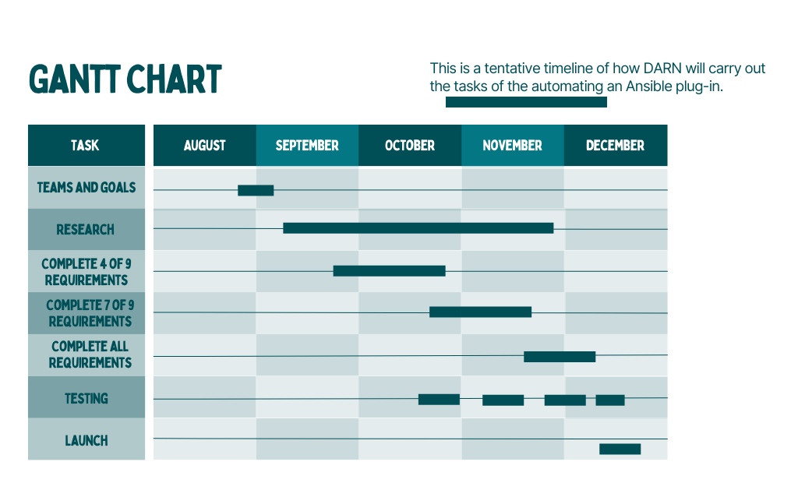
Timeline

Slide 10
References
https://docs.ansible.com/ansible/latest/plugins/plugins.html
https://docs.ansible.com/ansible/latest/dev_guide/developing_plugins.html
https://www.ansible.com/overview/how-ansible-works
https://www.youtube.com/watch?v=uIQE1_gomgw&ab_channel=ApetechTechTutorials
https://docs.ansible.com/ansible/latest/collections/ansible/builtin/index.html
https://developer.atlassian.com/server/confluence/confluence-server-rest-api/
https://docs.atlassian.com/ConfluenceServer/rest/8.4.2/
https://www.clairvoyant.ai/blog/confluent-platform-deployment-using-ansible-playbook
https://www.pandadoc.com/blog/how-to-automate-documentation/
https://docs.ansible.com/ansible/latest/playbook_guide/playbooks_vars_facts.html

